Slide 1
Logistic Regression

Slide 2
Classification
Classification problems
Email -> spam/not spam?
Online transactions -> fraudulent?
Tumor -> Malignant/benign
Where y is a discrete value
Develop the logistic regression algorithm to determine what class a new input should fall into
Variable in these problems is Y
Y is either 0 or 1
0 = negative class (absence of something)
1 = positive class (presence of something)
Start with binary class problems

Slide 3
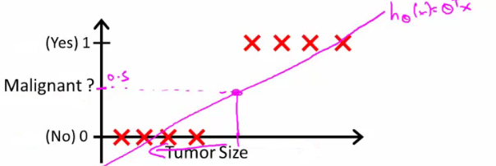
Classification with Linear regression
How do we develop a classification algorithm?
Tumour size vs malignancy (0 or 1)
We could use linear regression
Then threshold the classifier output (i.e. anything over some value is yes, else no)
In our example below linear regression with thresholding seems to work

Slide 4
We can see above this does a reasonable job of stratifying the data points into one of two classes
But what if we had a single Yes with a very small tumour
This would lead to classifying all the existing yeses as nos
But consider addition of a point

Slide 5
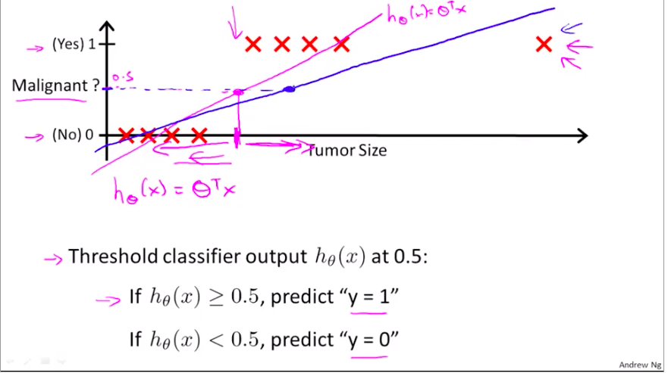

Slide 6
Another issues with linear regression
We know Classification Y is 0 or 1
Linear Regression Hypothesis can give values large than 1 or less than 0
So, logistic regression generates a hypothesis value is always either 0 or 1
Logistic regression is a classification algorithm

Slide 7
Hypothesis representation
What function is used to represent our hypothesis in classification
We want our classifier to output values between 0 and 1
When using linear regression we did h_{θ}(x) = (θ^{T} x)
For classification hypothesis representation we do h_{θ}(x) = g((θ^{T} x))
Where we define g(z)
z is a real number
g(z) = 1/(1 + e^{-z})
This is the sigmoid function, or the logistic function
If we combine these equations we can write out the hypothesis as

Slide 8
sigmoid function look like
Crosses 0.5 at the origin, then flattens out]
Asymptotes at 0 and 1

Slide 9
Interpreting hypothesis output
When our hypothesis (h_{θ}(x)) outputs a number, we treat that value as the estimated probability that y=1 on input x
Example
If X is a feature vector with x₀ = 1 (as always) and x₁ = tumourSize
h_{θ}(x) = 0.7
Tells a patient they have a 70% chance of a tumor being malignant
We can write this using the following notation
h_{θ}(x) = P(y=1|x ; θ)
What does this mean?
Probability that y=1, given x, parameterized by θ
Since this is a binary classification task we know y = 0 or 1
So the following must be true
P(y=1|x ; θ) + P(y=0|x ; θ) = 1
P(y=0|x ; θ) = 1 - P(y=1|x ; θ)
So chance of patient having tumour not malignant is 30%

Slide 11
Decision boundary
Gives a better sense of what the hypothesis function is computing
Better understand of what the hypothesis function looks like
One way of using the sigmoid function is;
When the probability of y being 1 is greater than 0.5 then we can predict y = 1
Else we predict y = 0
When is it exactly that h_{θ}(x) is greater than 0.5?
Look at sigmoid function
g(z) is greater than or equal to 0.5 when z is greater than or equal to 0
So if z is positive, g(z) is greater than 0.5
z = (θ^{T} x)
So when
θ^{T} x >= 0. Then h_{θ} >= 0.5
So what we've shown is that the hypothesis predicts y = 1 when θ^{T} x >= 0
The corollary of that when θ^{T} x <= 0 then the hypothesis predicts y = 0

Slide 12
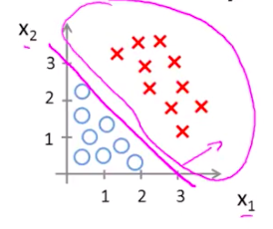
Decision boundary
h_{θ}(x) = g(θ₀ + θ₁x₁ + θ₂x₂)
So, for example
θ₀ = -3
θ₁ = 1
θ₂ = 1
So our parameter vector is a column vector with the above values
So, θ^{T} is a row vector = [-3,1,1]
What does this mean?
The z here becomes θ^{T} x
We predict "y = 1" if
-3x₀ + 1x₁ + 1x₂ >= 0
-3 + x₁ + x₂ >= 0
We can also re-write this as
If (x₁ + x₂ >= 3) then we predict y = 1
If we plot
x₁ + x₂ = 3 we graphically plot our decision boundary

Slide 13
Means we have these two regions on the graph
Blue = false
Magenta = true
Line = decision boundary
Concretely, the straight line is the set of points where h_{θ}(x) = 0.5 exactly
The decision boundary is a property of the hypothesis
Means we can create the boundary with the hypothesis and parameters without any data
Later, we use the data to determine the parameter values
i.e. y = 1 if
5 - x₁ > 0
5 > x₁

Slide 14
Non-linear decision boundaries
Get logistic regression to fit a complex non-linear data set
Like polynomial regress add higher order terms
So say we have
h_{θ}(x) = g(θ₀ + θ₁x₁+ θ₃x₁² + θ₄x₂²)
We take the transpose of the θ vector times the input vector
Say θ^{T} was [-1,0,0,1,1] then we say;
Predict that "y = 1" if
-1 + x₁² + x₂² >= 0 or
x₁² + x₂² >= 1
If we plot x₁² + x₂² = 1
This gives us a circle with a radius of 1 around 0

Slide 15
Mean we can build more complex decision boundaries by fitting complex parameters to this (relatively) simple hypothesis
More complex decision boundaries?
By using higher order polynomial terms, we can get even more complex decision boundaries

Slide 16
Cost function for logistic regression
Fit θ parameters
Define the optimization object for the cost function we use the fit the parameters
Training set of m training examples
Each example has is n+1 length column vector
This is the situation
Set of m training examples
Each example is a feature vector which is n+1 dimensional
x₀ = 1
y ∈ {0,1}
Hypothesis is based on parameters (θ)
Given the training set how to we chose/fit θ?

Slide 17
Linear regression uses the following function to determine θ
Instead of writing the squared error term, we can write
If we define "cost()" as;
cost(h_{θ}(x^{i}), y) = 1/2(h_{θ}(x^{i}) - y^{i})²
Which evaluates to the cost for an individual example using the same measure as used in linear regression
We can redefine J(θ) as
Which, appropriately, is the sum of all the individual costs over the training data (i.e. the same as linear regression)
To further simplify it we can get rid of the superscripts
So

Slide 18
What does this actually mean?
This is the cost you want the learning algorithm to pay if the outcome is h_{θ}(x) and the actual outcome is y
If we use this function for logistic regression this is a non-convex function for parameter optimization
Could work....
What do we mean by non convex?
We have some function - J(θ) - for determining the parameters
Our hypothesis function has a non-linearity (sigmoid function of h_{θ}(x) )
This is a complicated non-linear function
If you take h_{θ}(x) and plug it into the Cost() function, and them plug the Cost() function into J(θ) and plot J(θ) we find many local optimum -> non convex function
Why is this a problem
Lots of local minima mean gradient descent may not find the global optimum - may get stuck in a global minimum
We would like a convex function so if you run gradient descent you converge to a global minimum

Slide 19
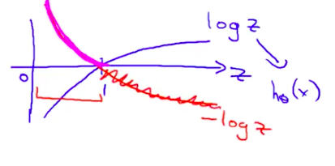
A convex logistic regression cost function
To get around this we need a different, convex Cost() function which means we can apply gradient descent
This is our logistic regression cost function
This is the penalty the algorithm pays
Plot the function
Plot y = 1
So h_{θ}(x) evaluates as -log(h_{θ}(x))

Slide 20
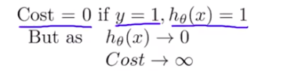
So when we're right, cost function is 0
Else it slowly increases cost function as we become "more" wrong
X axis is what we predict
Y axis is the cost associated with that prediction
This cost functions has some interesting properties
If y = 1 and h_{θ}(x) = 1
If hypothesis predicts exactly 1 and thats exactly correct then that corresponds to 0 (exactly, not nearly 0)
As h_{θ}(x) goes to 0
Cost goes to infinity i.e ( you are saying that there is no chance for you to have cancer (H(x) =0) and then he has cancer (y=1))
This captures the intuition that if h_{θ}(x) = 0 (predict P (y=1|x; θ) = 0) but y = 1 this will penalize the learning algorithm with a massive cost

Slide 21
What about if y = 0
then cost is evaluated as -log(1- h_{θ}( x ))
Just get inverse of the other function
Now it goes to plus infinity as h_{θ}(x) goes to 1

Slide 22
Simplified cost function and gradient descent
Define a simpler way to write the cost function and apply gradient descent to the logistic regression
By the end should be able to implement a fully functional logistic regression function
Logistic regression cost function is as follows

Slide 23
This is the cost for a single example
For binary classification problems y is always 0 or 1
Because of this, we can have a simpler way to write the cost function
Rather than writing cost function on two lines/two cases - Can compress them into one equation - more efficient
Can write cost function is
cost(h_{θ,} (x),y) = -ylog( h_{θ}(x) ) - (1-y)log( 1- h_{θ}(x) )
This equation is a more compact of the two cases above
We know that there are only two possible cases
y = 1
Then our equation simplifies to
-log(h_{θ}(x)) - (0)log(1 - h_{θ}(x))
-log(h_{θ}(x))
Which is what we had before when y = 1
So, in summary, our cost function for the θ parameters can be defined as
y = 0
Then our equation simplifies to
-(0)log(h_{θ}(x)) - (1)log(1 - h_{θ}(x))
= -log(1- h_{θ}(x))
Which is what we had before when y = 0

Slide 24
Why do we chose this function when other cost functions exist?
This cost function can be derived from statistics using the principle of maximum likelihood estimation
Also has the nice property that it's convex
To fit parameters θ:
Find parameters θ which minimize J(θ)
This means we have a set of parameters to use in our model for future predictions
Then, if we're given some new example with set of features x, we can take the θ which we generated, and output our prediction using
This result is p(y=1 | x ; θ)
Probability y = 1, given x, parameterized by θ

Slide 25
How to minimize the logistic regression cost function
Now we need to figure out how to minimize J(θ)
Use gradient descent as before
Repeatedly update each parameter using a learning rate
If you had n features, you would have an n+1 column vector for θ
This equation is the same as the linear regression rule
The only difference is that our definition for the hypothesis has changed
Previously, we spoke about how to monitor gradient descent to check it's working
Can do the same thing here for logistic regression
When implementing logistic regression with gradient descent, we have to update all the θ values (θ₀ to θ_{n}) simultaneously
Could use a for loop
Better would be a vectorized implementation
Feature scaling for gradient descent for logistic regression also applies here

Slide 26
Multiclass classification problems
Email Foldering – Family/Job/Hobby
Medical Diagnosis – Not ill/ Cold / Flu
Weather – Sunny/cloudy/rain/windy
Getting logistic regression for multiclass classification using one vs. all
Multiclass - more than yes or no (1 or 0)
Classification with multiple classes for assignment

Slide 27
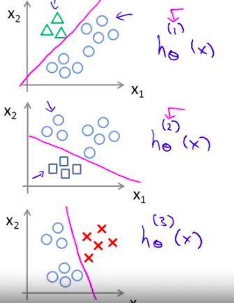
Given a dataset with three classes, how do we get a learning algorithm to work?
Use one vs. all classification make binary classification work for multiclass classification
One vs. all classification
Split the training set into three separate binary classification problems
i.e. create a new fake training set
Triangle (1) vs crosses and squares (0) h_{θ}¹(x)
P(y=1 | x₁; θ)
Crosses (1) vs triangle and square (0) h_{θ}²(x)
P(y=1 | x₂; θ)
Square (1) vs crosses and square (0) h_{θ}³(x)
P(y=1 | x₃; θ)

Slide 28
Overall
Train a logistic regression classifier h_{θ}^{(i)}(x) for each class i to predict the probability that y = i
On a new input, x to make a prediction, pick the class i that maximizes the probability that h_{θ}^{(i)}(x) = 1

